Slide 1



Slide 2

Issuer
Buyer
Commercial Real Estate Owner
Local Traders
Payout
Payout
Ground truth

Slide 3

HDD / CDD
HDD and CDD are measurements designed to quantify the demand for energy needed for heating/cooling a building based on outside temperature data.

Slide 4
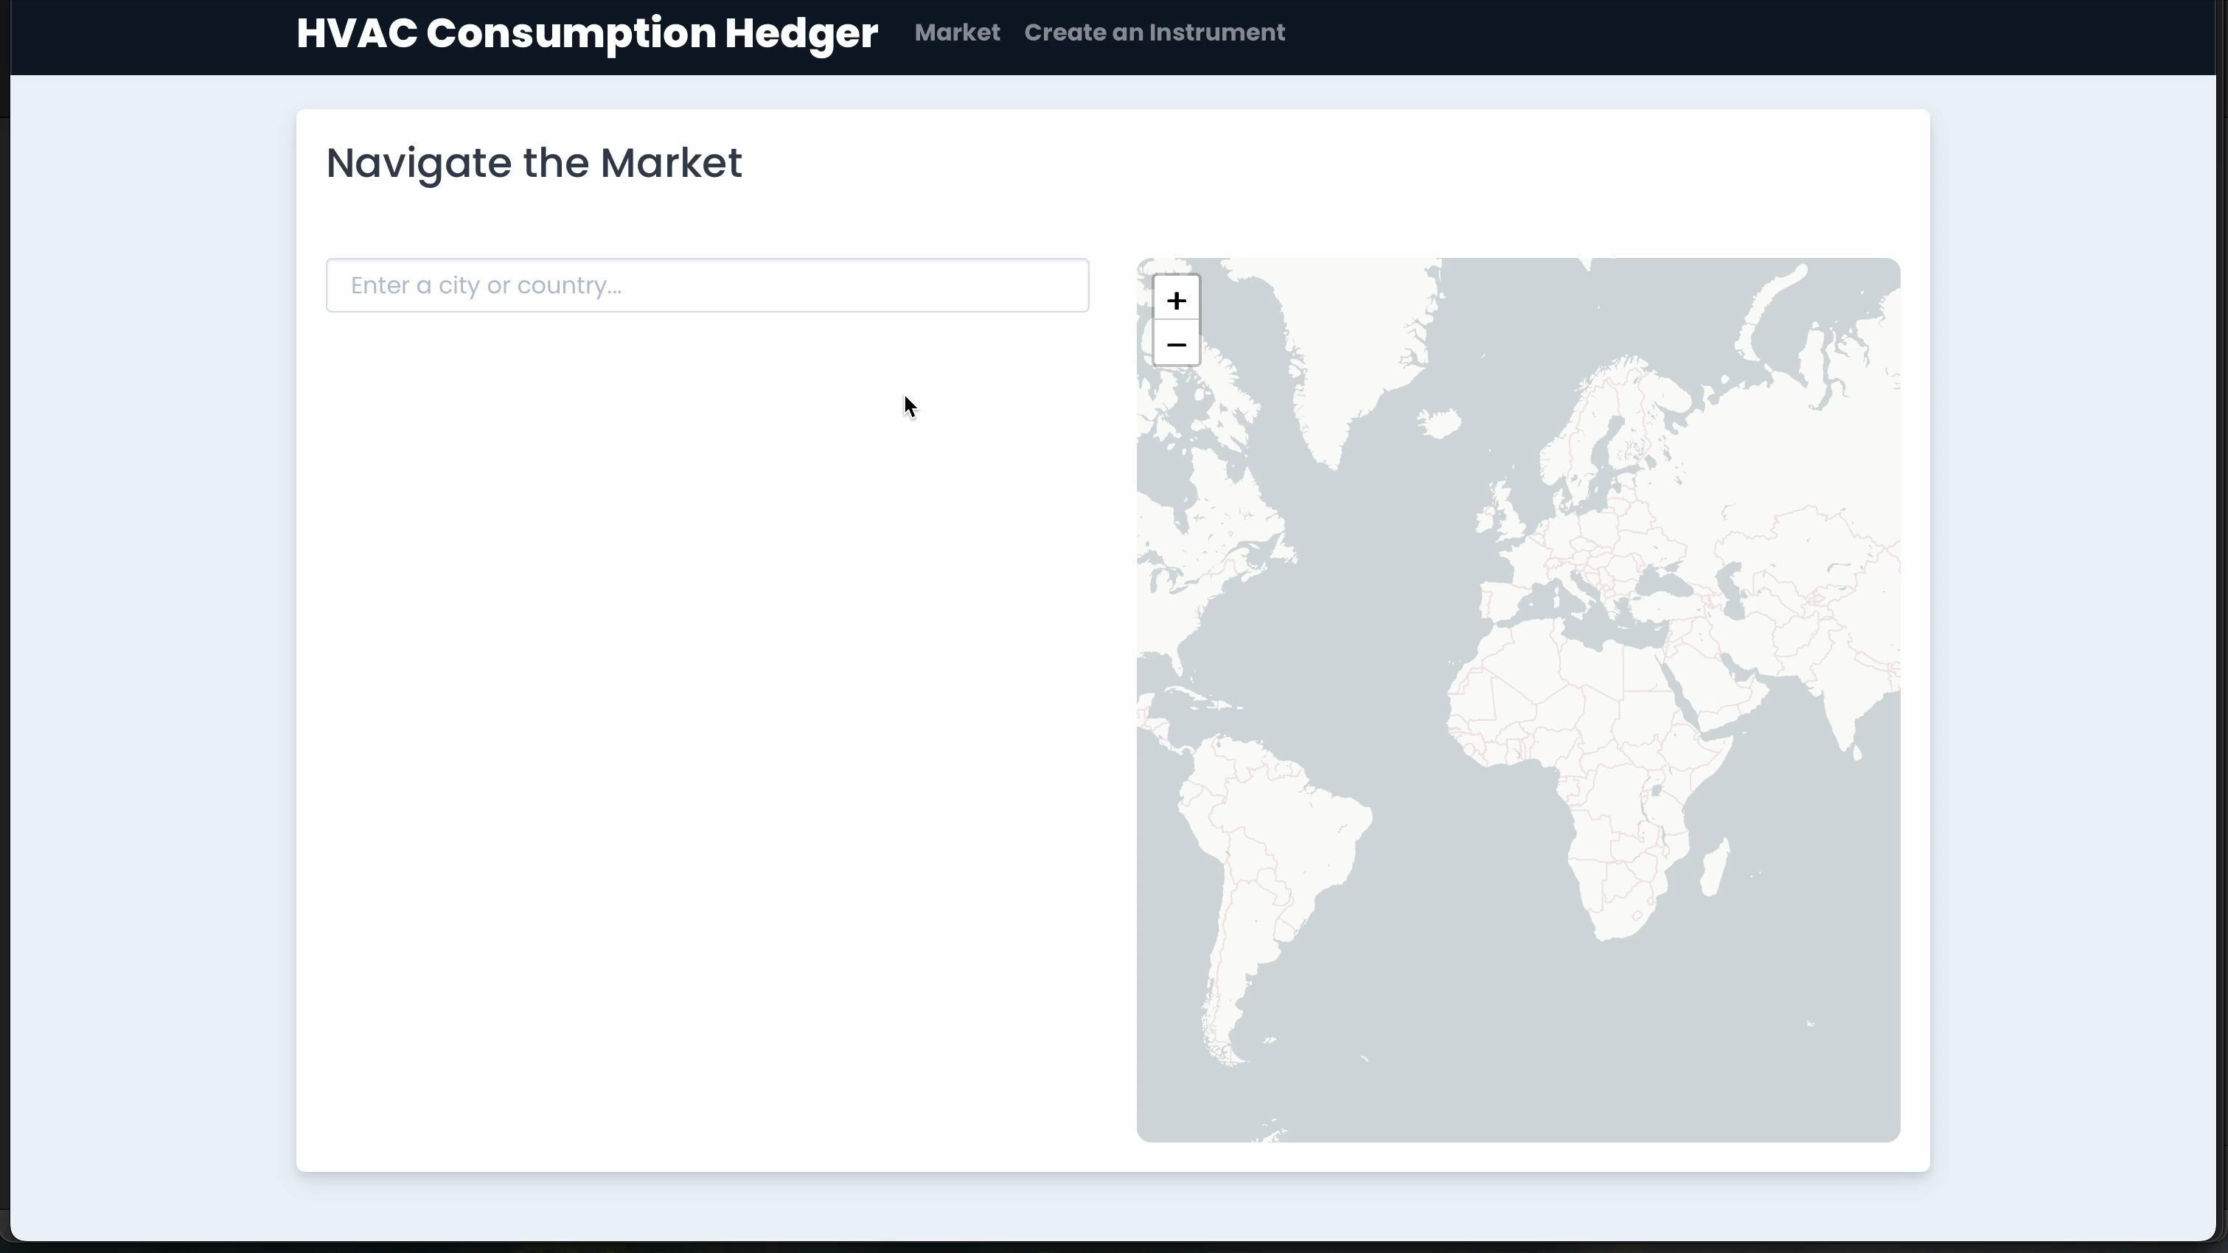

Slide 5
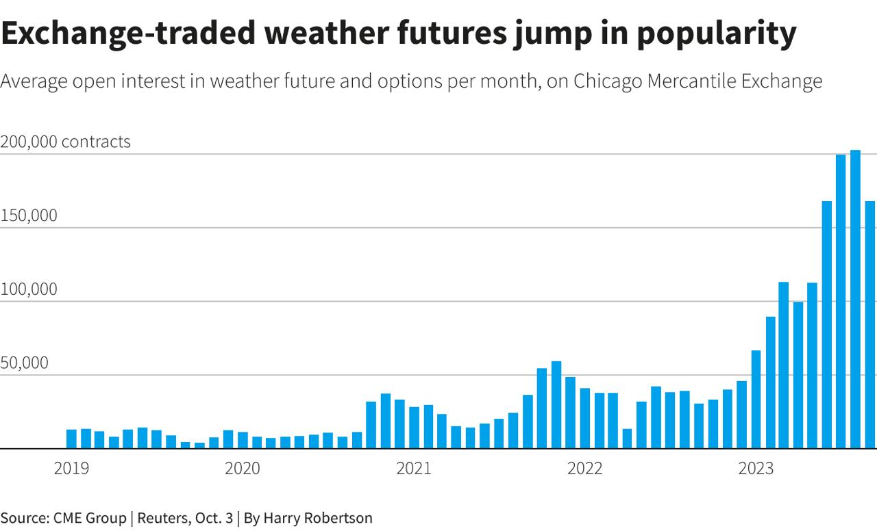

Slide 6
References
https://carboncredits.com/weathering-the-storm-the-rise-of-25b-weather-derivatives-market/
https://www.sciencedirect.com/science/article/abs/pii/S104402830700021X
https://thedocs.worldbank.org/en/doc/29d15a97a9791b5e6cfac1c302d08f08-0340012023/original/product-note-index-based-weather-derivative.pdf

